Slide 1

Recycle and Reuse in Environmental Remediation
Information Security Fundamentals | Environmental Pollution and Remediation
Course: Information Security Fundamentals | Chapter: Environmental Pollution and Remediation | Program: Bachelor of Engineering
DISCOVER · LEARN · EMPOWER
Notes:
Welcome everyone to today's session on Recycle and Reuse within our Environmental Pollution and Remediation chapter. This topic is critical for understanding how we mitigate human impact on ecosystems. As we explore this, remember that our goal is to transform waste into resources effectively.

Slide 2
Course Outcomes
SLIDE 2 / 14
Course Outcome
CO | BT LEVEL | DESCRIPTION
CO1 | BT4 | Recall, analyze and respond on fundamental environmental principles, such as ecological relationships and conservation strategies
CO2 | BT4 | Understand and analyze the interconnections between human activities and environmental impacts across different ecosystems
CO3 | BT4 | Understand and analyze and apply environmental laws and policies to analyse and propose solutions for real-world environmental challenges.
CO4 | BT2 | Students will analyse data from environmental monitoring programs to assess trends and predict future impacts on ecosystems.
CO5 | BT6 | Interpret, elaborate and propose various tools, design and innovative strategies for sustainable development and environmental conservation initiatives in securing the planet.
Chandigarh University
2 / 14
Notes:
Today's lecture directly addresses Course Outcome 2, which requires us to analyze how human activities like waste disposal impact ecosystems. By mastering recycling and reuse, you learn to break the cycle of pollution. This outcome ensures you can evaluate the environmental consequences of our consumption patterns.

Slide 3
Learning Objectives
SLIDE 3 / 14
Learning Outcomes
1
Analyze the fundamental differences between recycling and reusing materials effectively.
2
Evaluate the quantitative benefits of recycling on energy consumption and resource conservation.
3
Apply remediation principles to classify waste streams for optimal recycling strategies.
4
Calculate the environmental impact reduction achieved through specific reuse protocols.
Chandigarh University
3 / 14
Notes:
By the end of this session, you will be able to distinguish clearly between recycling and reusing. We will analyze how these processes differ in their energy requirements and environmental outcomes. You will also learn to apply these concepts to real-world waste management scenarios.

Slide 4
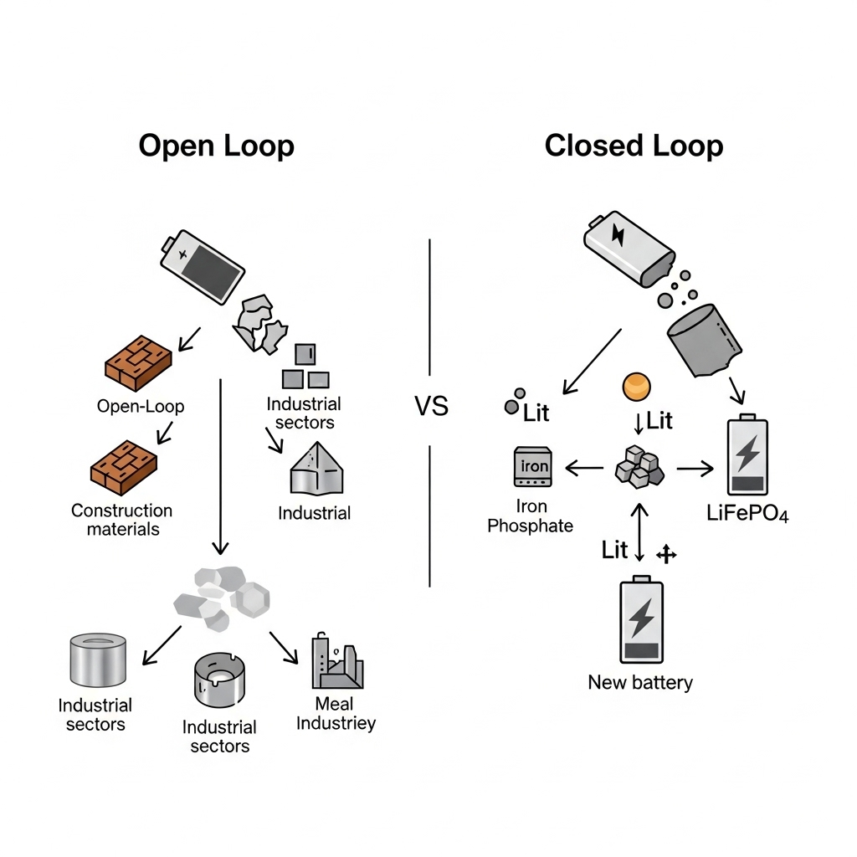
Lecture
SLIDE 4 / 14
Defining Recycling and Reuse
1
Recycling converts waste materials into new products through industrial processing.
2
Reuse involves using an item again for the same or new purpose.
3
Recycling requires energy input to break down materials into raw forms.
4
Reuse extends product life without requiring significant energy for processing.
5
Both strategies reduce the volume of waste sent to landfills significantly.
LiFePO4 Battery Recycling: Open-Loop vs. Closed-Loop - Anern
Chandigarh University
4 / 14
Notes:
Recycling is a process where waste is broken down, like melting plastic bottles to make new ones. Reuse is simpler, like refilling a glass jar for storage. The key difference is the energy required; recycling consumes more energy than reuse. Understanding this distinction is vital for effective environmental remediation strategies.

Slide 5
Lecture
SLIDE 5 / 14
The Hierarchy of Waste Management
1
The waste hierarchy prioritizes reduction, reuse, recycling, recovery, and disposal.
2
Reuse is ranked higher than recycling because it saves more energy.
3
Recycling is the third best option after source reduction and reuse.
4
Disposal at the bottom represents the least environmentally friendly option.
5
Effective remediation requires shifting focus from disposal to reuse and recycling.
Chandigarh University
5 / 14
Notes:
Think of the waste hierarchy as a pyramid where the top is best. Reuse sits above recycling because it avoids the energy cost of reprocessing. Recycling is still better than disposal, but it is not the ultimate solution. We must aim to reduce waste first, then reuse, then recycle.

Slide 6
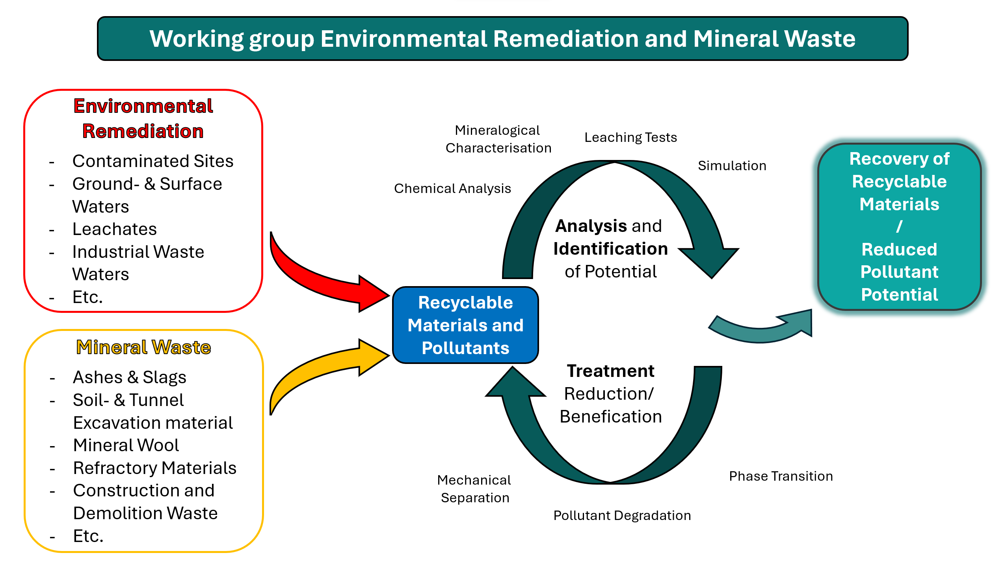
Lecture
SLIDE 6 / 14
Recycling Process Mechanics
1
Collection involves gathering recyclable materials from households and industries.
2
Sorting separates materials like paper, plastic, glass, and metals efficiently.
3
Processing breaks down materials into raw feedstock for manufacturing.
4
Manufacturing transforms raw feedstock into new consumer products.
5
Market demand drives the economic viability of the recycling loop.
Working group "Environmental Remediation and Mineral Waste" (source: www.unileoben.ac.at)
Chandigarh University
6 / 14
Notes:
The recycling process starts with collection, where we gather materials like aluminum cans. Sorting is crucial; if we mix paper with plastic, the whole batch can be ruined. Processing then breaks these down, turning an old can into raw aluminum. Finally, manufacturers use this raw material to make new products.

Slide 7
Lecture
SLIDE 7 / 14
Reuse Strategies in Remediation
1
Direct reuse extends the life of products without any processing.
2
Indirect reuse repurposes items for different functions than originally intended.
3
Industrial symbiosis allows waste from one process to become input for another.
4
Refurbishment restores used equipment to near-new operational standards.
5
Reuse reduces the demand for virgin raw materials significantly.
Chandigarh University
7 / 14
Notes:
Direct reuse is as simple as using a glass jar again for storage. Indirect reuse might involve turning old tires into playground surfaces. Industrial symbiosis is a powerful concept where one factory's waste becomes another's raw material. This approach is a cornerstone of modern environmental remediation.

Slide 8
Lecture
SLIDE 8 / 14
Energy Savings in Recycling
1
Recycling aluminum saves approximately 95% of the energy required for primary production.
2
Recycling steel saves about 60% of the energy compared to virgin ore.
3
Recycling paper saves roughly 40% of the energy and water usage.
4
Recycling plastic saves about 70% of the energy compared to new plastic.
5
Energy savings directly correlate with reduced greenhouse gas emissions.
Working group "Environmental Remediation and Mineral Waste" (source: www.unileoben.ac.at)
Chandigarh University
8 / 14
Notes:
Let's look at the numbers. Recycling aluminum saves 95% of the energy needed to make new aluminum from bauxite ore. This is a massive saving because extracting and refining bauxite is extremely energy-intensive. Similarly, recycling steel saves 60% of the energy. These savings are critical for reducing our carbon footprint.

Slide 9
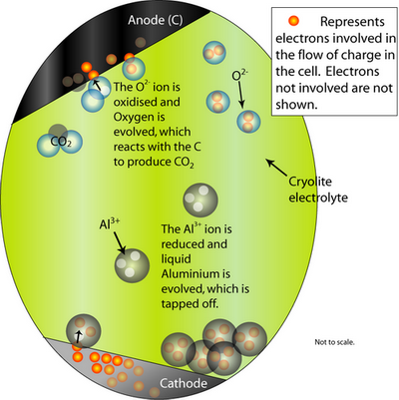
Worked Example
SLIDE 9 / 14
Aluminum Recycling
GOVERNING EQUATION
Energy saved per kilogram = 14 kWh - 0.7 kWh = 13.3 kWh
1
Primary aluminum production requires 14 kWh of energy per kilogram of metal.
2
Recycled aluminum production requires only 0.7 kWh of energy per kilogram.
3
Percentage energy saved = (13.3 / 14) × 100% = 95%.
4
This calculation demonstrates the immense efficiency of recycling aluminum.
Source: www.doitpoms.ac.uk
Chandigarh University
9 / 14
Notes:
Let's do a quick calculation. Primary aluminum production takes 14 kilowatt-hours per kilogram. Recycling takes only 0.7 kilowatt-hours. The difference is 13.3 kilowatt-hours saved per kilogram. When we divide this by the original 14, we get a 95% saving. This single example proves why recycling is so vital.

Slide 10
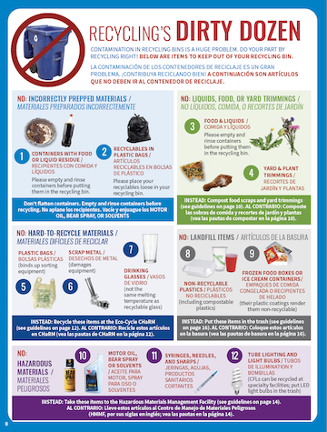
Lecture
SLIDE 10 / 14
Common Pitfalls in Recycling
1
Contamination from food residue ruins entire batches of recyclable paper.
2
Incorrect sorting sends non-recyclable items into processing streams.
3
Downcycling reduces material quality, limiting future reuse potential.
4
Market fluctuations can make recycling economically unviable temporarily.
5
Consumer confusion leads to improper disposal of recyclable items.
Source: ecocycle.org
Chandigarh University
10 / 14
Notes:
One major pitfall is contamination. If you put a greasy pizza box in the paper recycling, it can ruin the whole batch. Another issue is downcycling, where plastic is turned into lower-quality products that cannot be recycled again. Consumer confusion also plays a role; people often throw non-recyclables into the bin.

Slide 11
Lecture
SLIDE 11 / 14
Environmental Impact Analysis
1
Recycling reduces the need for mining and logging virgin resources.
2
Reuse prevents the extraction of raw materials entirely.
3
Both methods significantly lower greenhouse gas emissions from manufacturing.
4
Recycling reduces water consumption in industrial processing stages.
5
Remediation through recycling restores ecosystem balance over time.
Working group "Environmental Remediation and Mineral Waste" (source: www.unileoben.ac.at)
Chandigarh University
11 / 14
Notes:
When we recycle, we stop needing to mine new ore or cut down new trees. This preservation of natural resources is a key part of remediation. Furthermore, the energy savings we discussed earlier directly translate to lower greenhouse gas emissions. This helps restore the balance of our ecosystems.

Slide 12
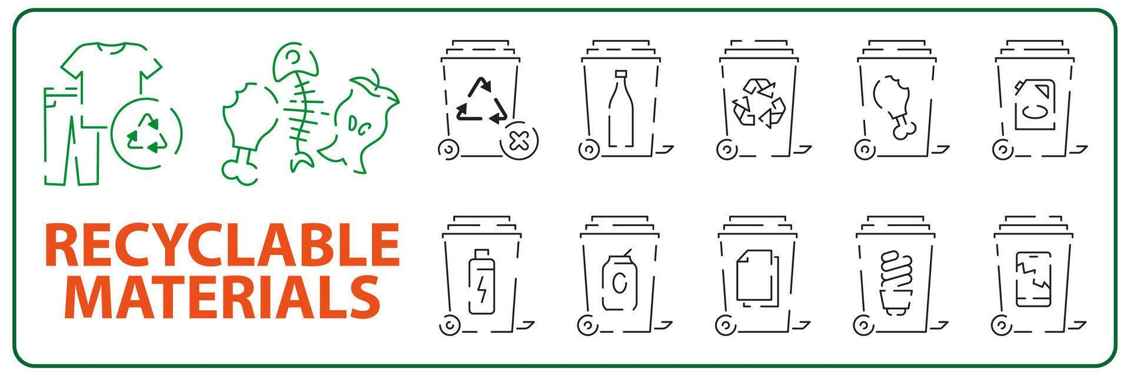
Lecture
SLIDE 12 / 14
Classification of Recyclable Materials
1
Metals like aluminum and steel are infinitely recyclable without quality loss.
2
Glass can be recycled endlessly but requires high melting temperatures.
3
Paper and cardboard degrade in quality after each recycling cycle.
4
Plastics are categorized by resin codes for proper sorting and processing.
5
Electronics require specialized recycling due to hazardous components.
Source: static.vecteezy.com
Chandigarh University
12 / 14
Notes:
Not all materials are created equal. Metals like aluminum can be recycled infinitely without losing quality. Glass is similar but requires high heat. Paper, however, degrades with each cycle, meaning it can only be recycled a few ×. Plastics are complex and require sorting by resin codes.

Slide 13
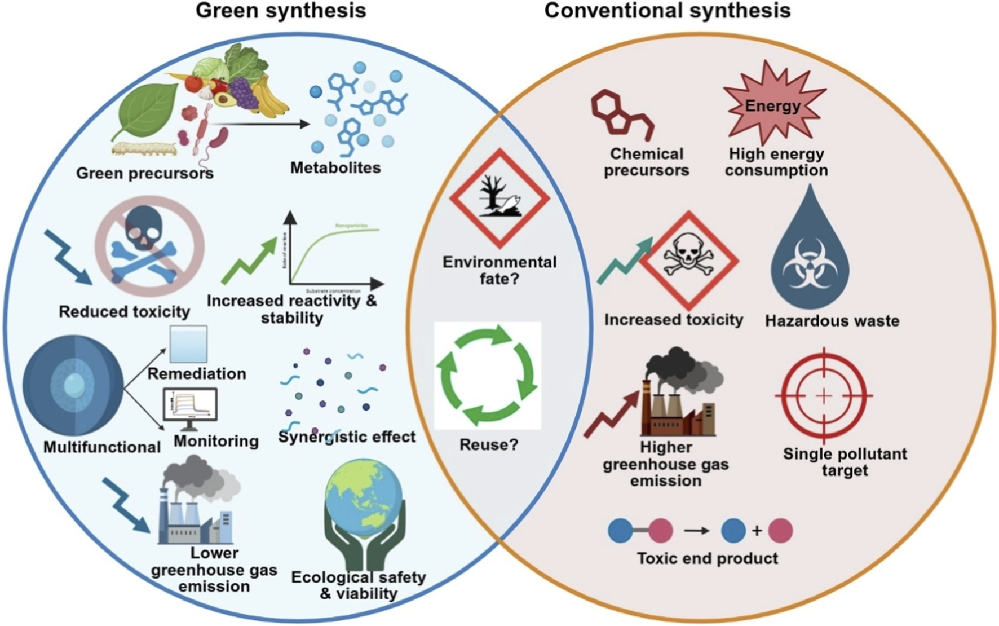
Lecture
SLIDE 13 / 14
Key Takeaways
1
Recycling converts waste to raw materials, while reuse extends product life.
2
Reuse is energetically superior to recycling in the waste hierarchy.
3
Aluminum recycling saves 95% of energy compared to primary production.
4
Contamination and downcycling are major challenges in recycling systems.
5
Effective remediation requires prioritizing reduction, reuse, and then recycling.
Source: www.frontiersin.org
Chandigarh University
13 / 14
Notes:
To summarize, recycling and reuse are distinct but complementary strategies. Reuse is the most energy-efficient option, followed by recycling. We saw that recycling aluminum saves 95% of energy. Remember that contamination and downcycling are pitfalls to avoid. Prioritizing these strategies is essential for environmental remediation.

Slide 14
Lecture
SLIDE 14 / 14
References
ENVIRONMENTAL STUDIES
From Crisis to Cure — R. Rajagopalan
• Environmental Science and Engineering — Benny Joseph
• Environmental Studies — R.C. Sharma and D. Gurbir Sangha
• Introduction to Environmental Science — Anjaneyulu, Y.
• Environmental Pollution Control Engineering — C.S. Rao
• Textbook of Environmental Studies for undergraduate courses — E. Bharucha
• Environmental Science — S.C. Santra
Chandigarh University
14 / 14
Notes:
These references provide the foundational knowledge for today's lecture. Benny Joseph and R.C. Sharma offer detailed insights into environmental engineering. Anjaneyulu and C.S. Rao provide specific technical details on pollution control. E. Bharucha and R. Rajagopalan offer broader perspectives on environmental studies.

